Slide 1
The Development of School Psychology Assessment Centers: Training, Service Delivery and Research
Nina Ellis-Hervey Ph.D., NCSP, LSSP
Alison Bradford, M.A.
DeShae Davis, B.S.
Stephen F. Austin State University
22nd Annual State Conference

Slide 2
Mini-Skills Workshop Parts
Why a School Psychology Assessment Center (SPAC)?
Where do I (WE) Begin?
Part I- Creating a Successful Proposal for Your SPAC
Part II- Creating Required Paperwork for Your SPAC
Part III- Seeking Paperwork Approval (University Counsel)
Part IV- Training Personnel
Part V- Items Needed for Your Center
Part VI- Finding a “Proper” Assessment Space
Part VII- Marketing Your Services
Part VIII- Maintaining Client Records
Part IX- Maintaining the Life of Your Center

Slide 3
Goals for Today
This mini skills workshop will focus on sharing the effective methods of developing these SPACs and what should be done before, during and after the center has been established.
This mini skills workshop will also focus on the difficulties and obstacles encountered when on this journey.

Slide 4
Why a School Psychology Assessment Center?

Slide 5
Why a SPAC Center?
According to the National Association of School Psychologist Ethical Principles (2010), School Psychologists have an ongoing responsibility to promote and support healthy schools, families and communities while:
Contributing to the knowledge and research base
Mentoring
Teaching
Supervising

Slide 6
Why a SPAC Center?
School Psychology programs should seek to meet these goals by providing their students with opportunities to engage in meaningful research, learn effective service delivery, participate in outreach services and continue in professional development.

Slide 7
Why a SPAC Center?
Programs in School Psychology seem to have several interests focused on helping their respective programs grow and thrive for years to come while creating such impeccable training environments and educating communities on the profession.

Slide 8
Why a SPAC Center?
The development of SPACS are an excellent investment in helping to meet the positive goals School Psychologists seek to achieve.

Slide 9
Where do I (WE) Begin?

Slide 10
Where do I (WE) Begin?
The development of SPACs are no easy feat and require the assistance and dedication of many personnel.
Students
Graduate assistants
Faculty
Department chairs
Deans
Provosts
Presidents
University Counsel

Slide 11
Where do I (WE) Begin?
This quest also requires:
Hours of your time
Patience
Development of relationships
Marketing and more (before, during and after your center is up and running)

Slide 12
Where do I (WE) Begin?
Where do I retrieve a guide on how to take on this task?
There is a dearth in the literature related to creating such centers and the steps to their start and completion.
Some authors address best practices in school-based mental health services and their use (Atkins et al. 2001; Atkins et al 2003; Doll & Cummings 2008; Flaherty & Osher 2003; Flaherty & Weist 1999; Jacoby 2005; Paternite 2004; Rones & Hoagwood 2000; Weist, M. et al. 2003)
However, there is very little on the creation, development and how to sustain a SPAC.
There is some information on starting a private practice in psychology (Smith-Baily, 2003).
Some of the process is similar.

Slide 13
Part I
Creating a Successful Proposal for Your SPAC

Slide 14
Creating a Successful Proposal
Determine the goals and objective you have for your center and ask yourself:
Who will receive services?
Will research activities be involved?
How can this create outreach opportunities?
How will this help students?
How will this help faculty?
How will this help your department?
How will this help your university?
How will this help the greater community?

Slide 15
The Mission
What is the mission’s purpose when creating a SPAC?

Slide 16
The Mission
Develop your center mission by:
Looking at the goals and objectives of your:
University
Department
Program
Community
What are the REAL needs?
Who is requesting assistance most?
What is the missing link where you are?
How can you “bridge the gap”?
What will make your center different from those around?
Who will benefit and how?
Describe who will assist in this mission and ensure it is upheld
Be clear and direct about the practices to be used in your center.

Slide 17
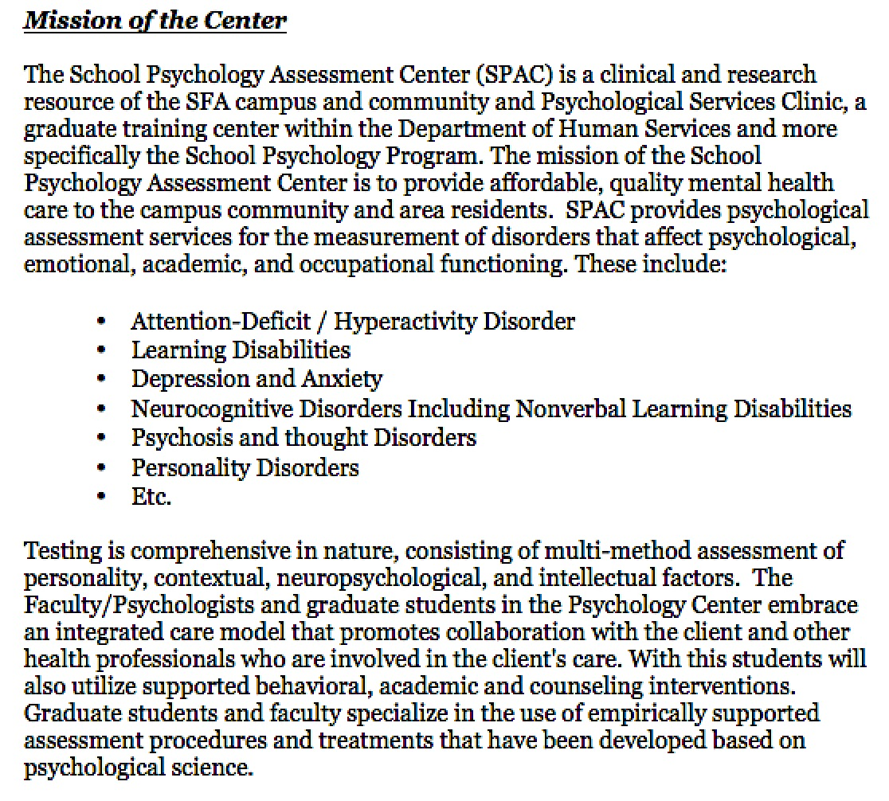
Mission Example

Slide 18
Principle Activities
Principle Activities:
Those activities that take the most precedence when describing the function of your center
These are important as you establish the center so you align your goals and objectives as others are informed of your services.
Provide not only the activity, but attempt to allocate a percentage to the highest activity(s) on the list.

Slide 19
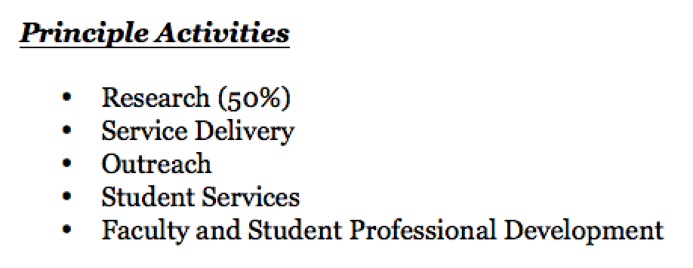
Principle Activities Example

Slide 20
Describing Your Activities
GOALS and OBJECTIVES

Slide 21
Research Activities Reviewed
Research:
Describe the ultimate goals of your research through distinct goals and objectives:
What will you investigate and study?
Who will participate in this research?
What populations will be targeted for your research?
Is this required research?
Who will this research help?
Will you collaborate?

Slide 22
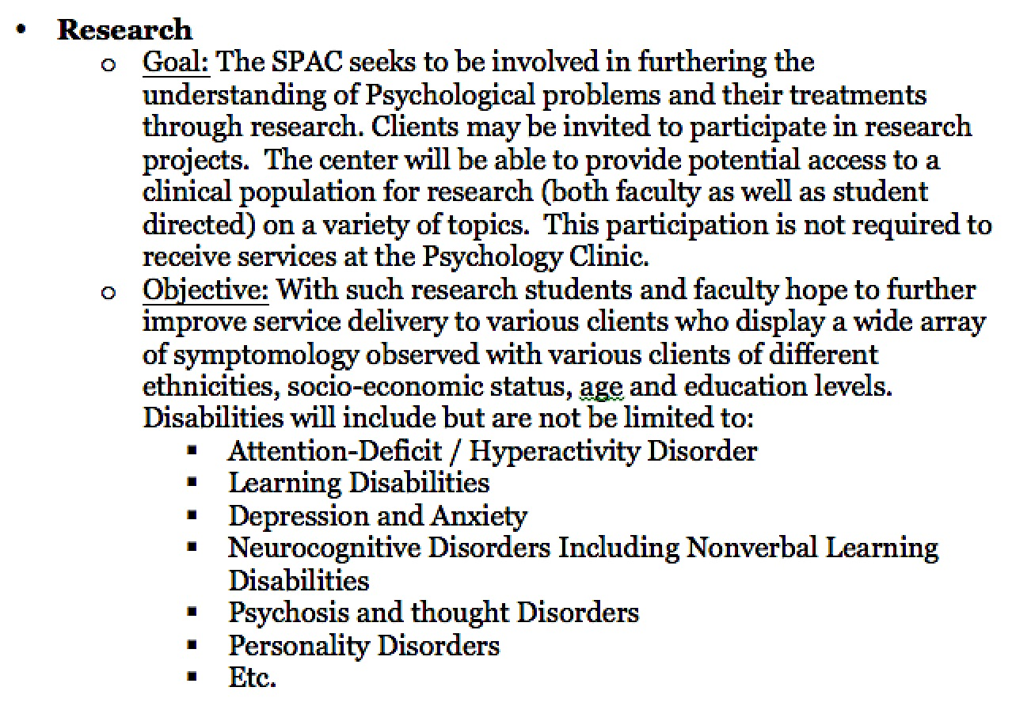
Research Activities Example

Slide 23
Service Delivery Activities Reviewed
Service Delivery:
Describe the ultimate goals of your service delivery methods through distinct goals and objectives
What kind of services will be offered?
Who will receive these services?
What types of assessments will be used?
What is the overall scope in service?
Will intervention methods be taught/explored?
What methods will be employed by your center?

Slide 24
Service Delivery Example

Slide 25
Outreach and Student Services Activities Reviewed
Outreach and Student Services:
Describe the ultimate goals of your outreach methods and student reach through distinct goals and objectives:
How will your center be different?
Who will it reach?
Who will know about services?
Who will be informed and how?
Sliding scale fees offered?
Diverse populations?
Underserved populations?

Slide 26
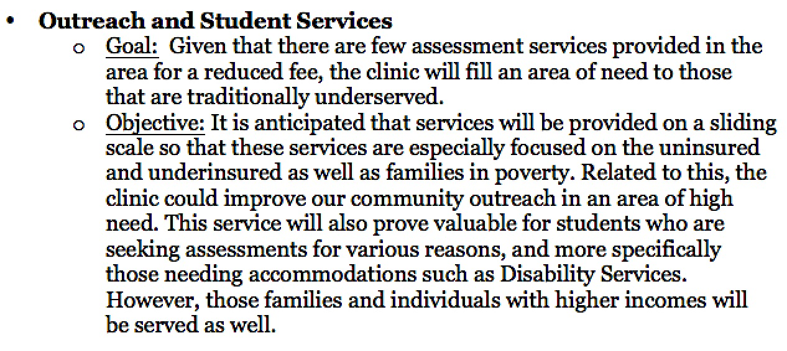
Outreach and Student Services Example

Slide 27
Faculty and Student Professional Development Activities Reviewed
Faculty and Student Professional Development:
Think critically and describe how your center will not only fulfill your proposed mission, but that of your department and program.
How will students be benefited?
How will faculty benefit?
What specific skills will be enhanced/strengthened?
What will be the guided initiatives?

Slide 28
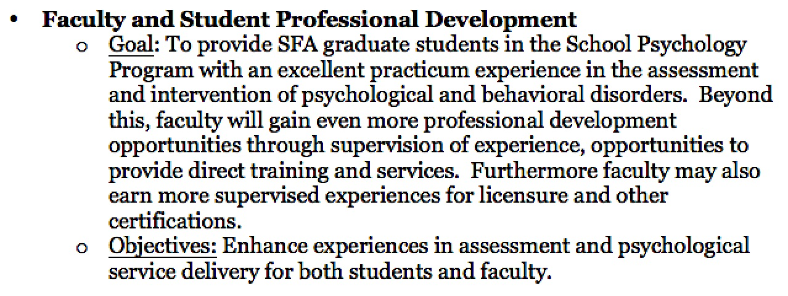
Faculty and Student Professional Development Example

Slide 29
Creating the Organization of Your Center
Who, What, When, Where???

Slide 30
Organization of Your Center
When creating your SPAC, you must cover all aspects of it:
Who will the center report to?
Who will be your SPAC director?
What will be their immediate duties?
Who will provide supervision?
What are their credentials?
Could this person change?
Are course releases needed in order to adequately setup/keep the center in consistent operation?

Slide 31
Organization of Your Center (con’t)
Who will assist in daily operations?
Data collection
Treatment provision
Building databases
Development and maintenance of the center web site,
Involvement with direct consultation with service providers along with the director
What will be the eventual trajectory of this assistance?
Office set up
E-mails
Providing information
Etc.

Slide 32
Organization of Your Center (con’t)
Who will complete the services mentioned in the center description?
Who will be invited to assist?

Slide 33
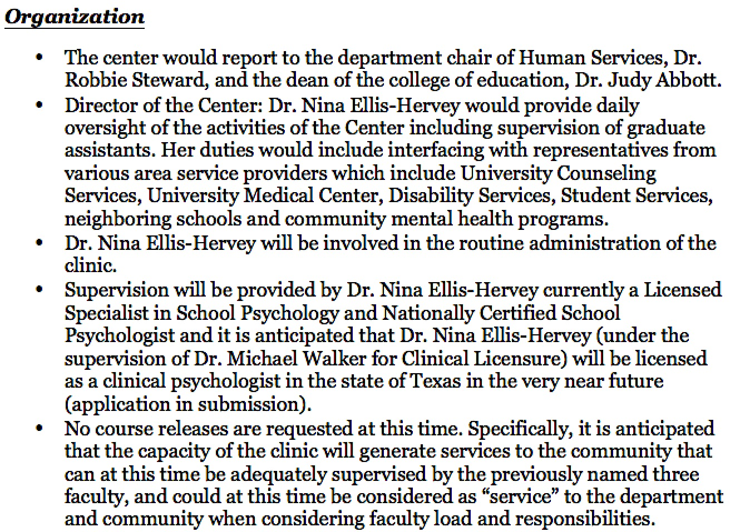
Organization of Your Center Example

Slide 34
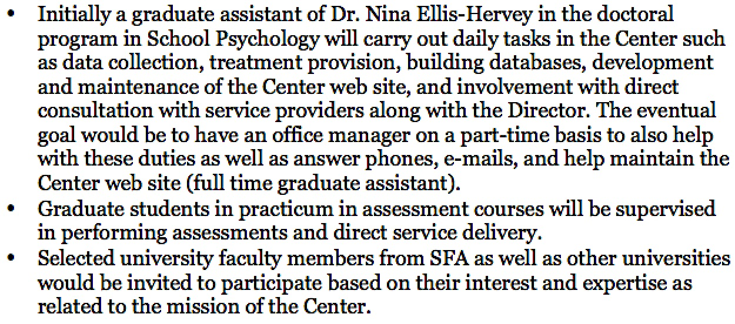
Organization of Your Center Example

Slide 35
Finding Resources for Your Center

Slide 36
Finding Resources
In the process of proposing your center, a HUGE inquiry is where funds will come from to start, maintain and adequately operate your SPAC.
Who will funding be sought from?
Who/what might be targeted?
Grants/education funds/department funds etc.
Before proposing this, check your department/school for available funding or opportunities

Slide 37
Finding Resources
Answer specific questions:
Will services generate funding?
Has anything already been purchased/used towards this effort?
Where will your SPAC be housed?
Is there additional spacing and places for assessments to be performed?
Ensure those who are in charge of these spaces have been informed and made aware of your intentions!!!

Slide 38
Creating a Budget for Your Center

Slide 39
Creating Your Budget
Your budget may be quite small in the beginning, however, make mention of any resources you may use to allocate for your SPAC.
If no funds are needed explicitly make mention of that.
Make mention of general future expenses.
If your budget will be supported by the earned center revenue, make that clear and ensure that pricing forms are attached (to be presented later).

Slide 40
Example Statement for Budgeting

Slide 41
Part II
Creating Required Paperwork for Your SPAC

Slide 42
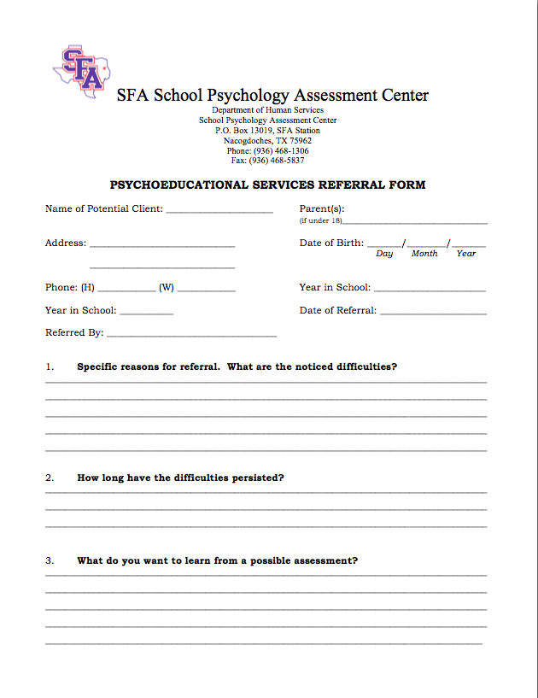
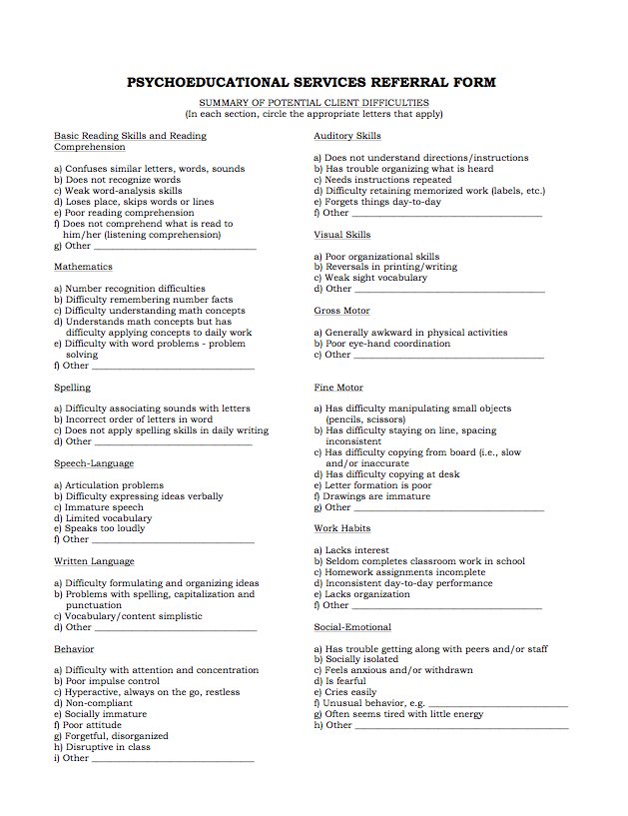
Client Paperwork
Referral Form

Slide 43
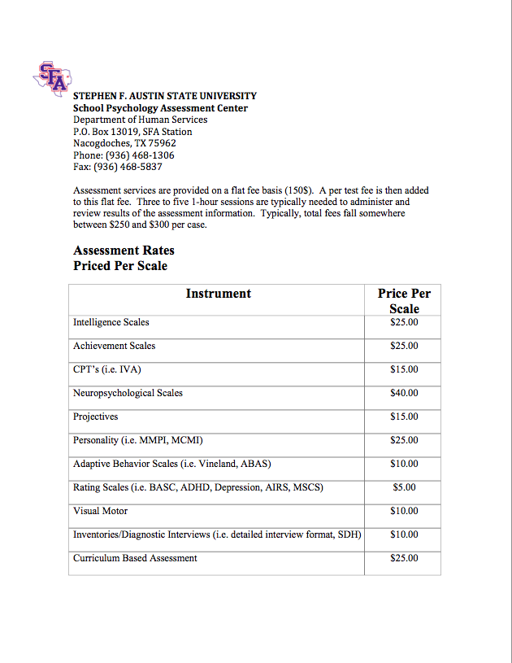
Client Paperwork
Pricing Form

Slide 44
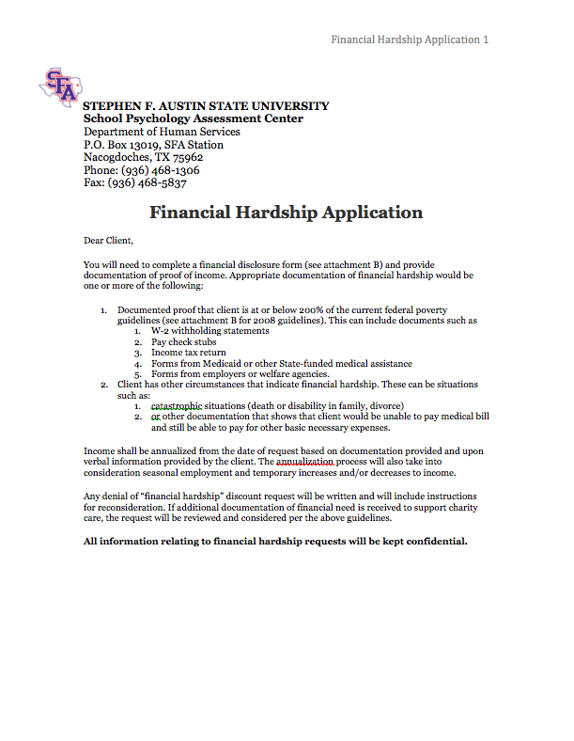
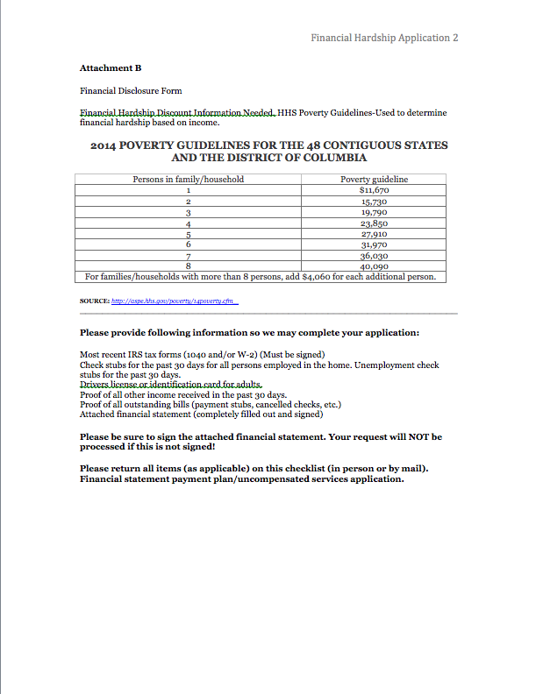
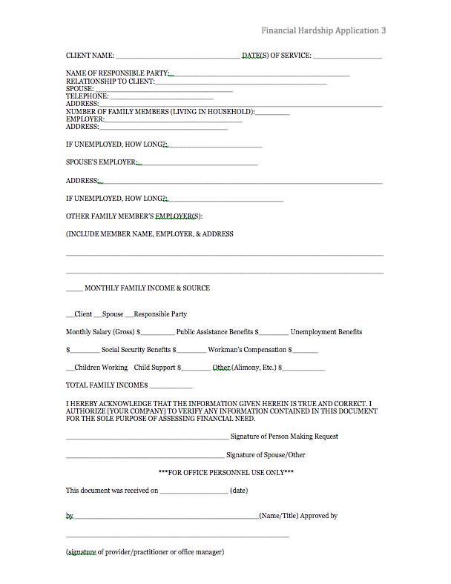
Client Paperwork
Financial hardship form

Slide 45
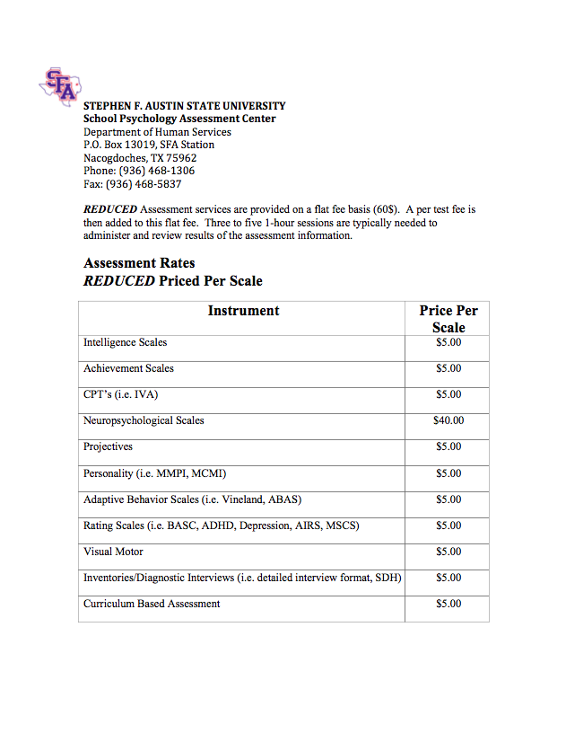
Client Paperwork
Reduced pricing list

Slide 46
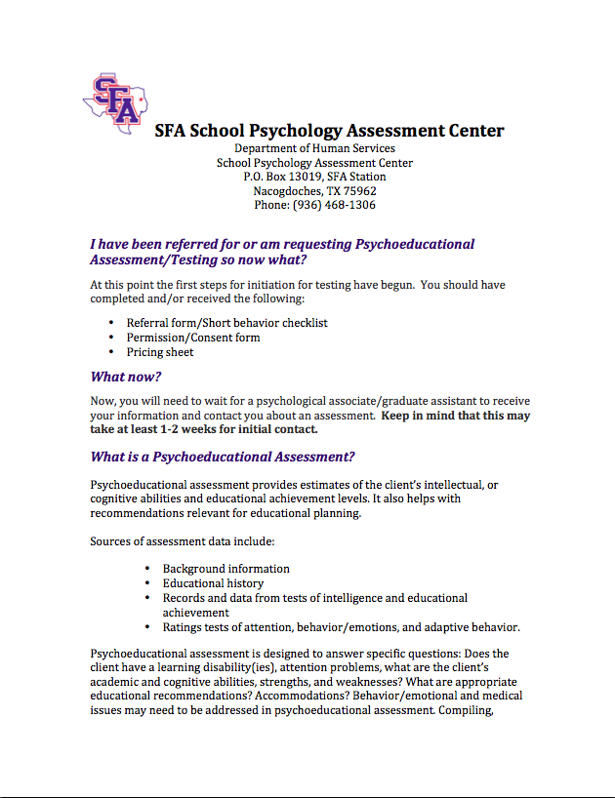
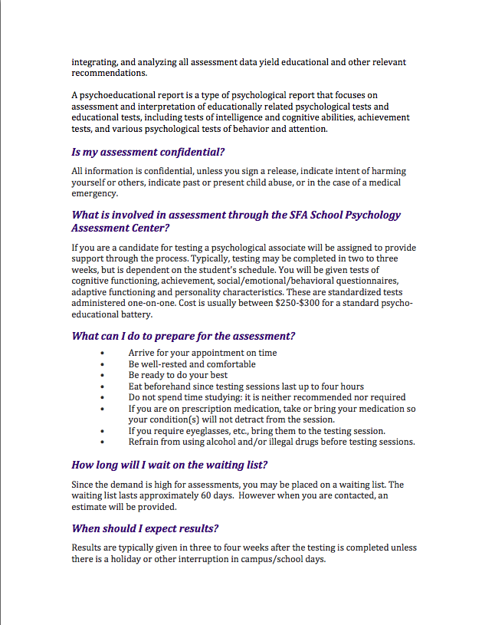
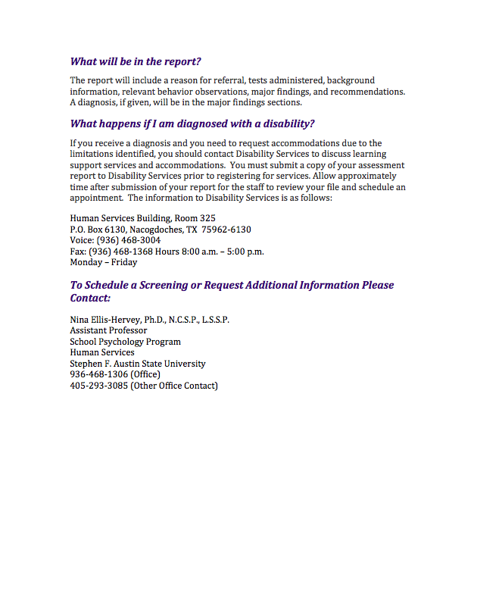
Client Paperwork
What Now form

Slide 47
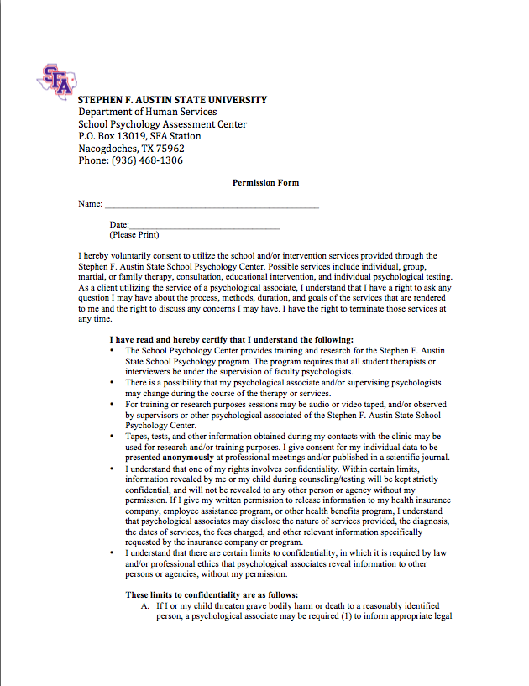
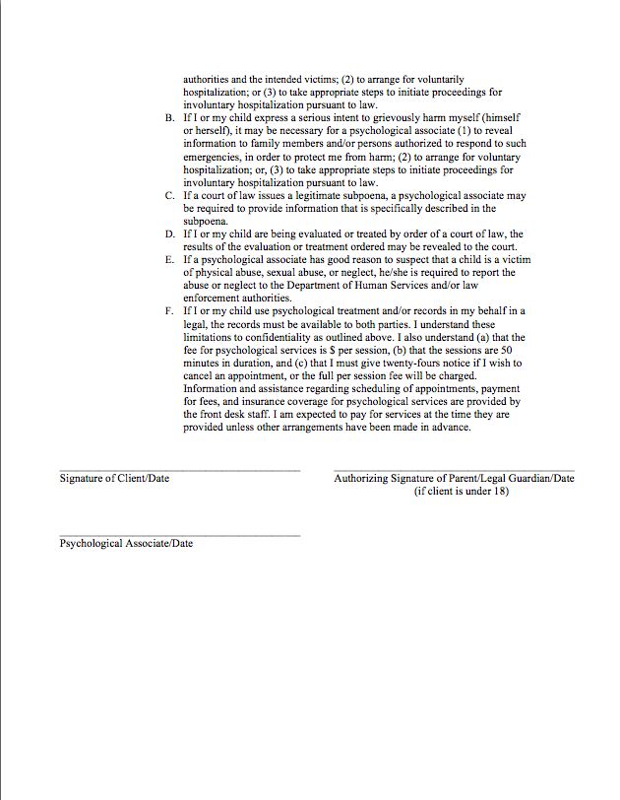
Client Paperwork
Permission form

Slide 48
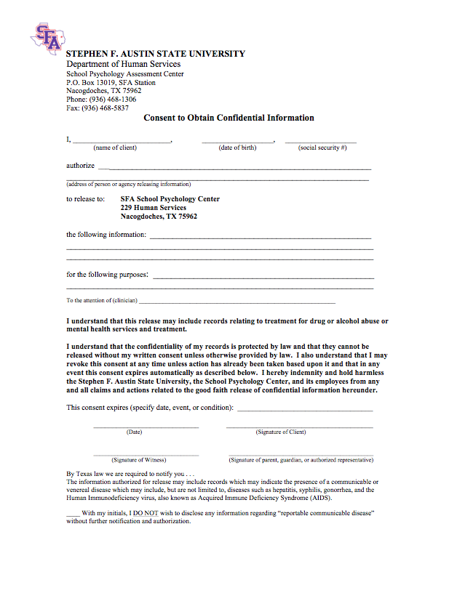
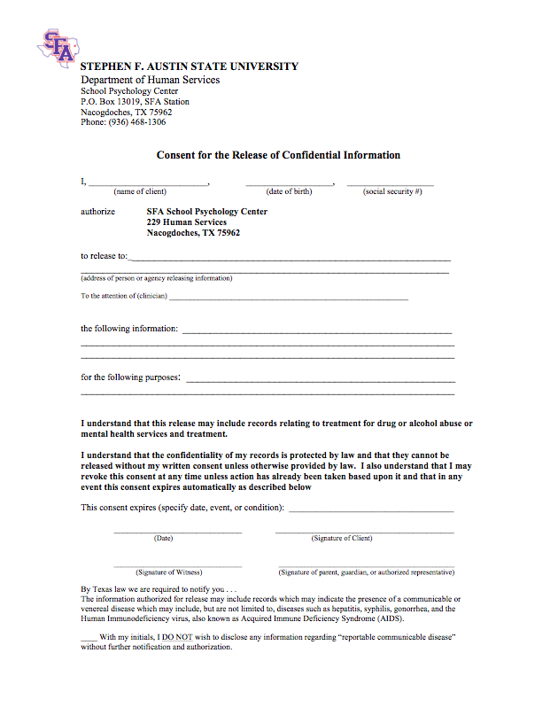
Client Paperwork
Consent to obtain and release information

Slide 49
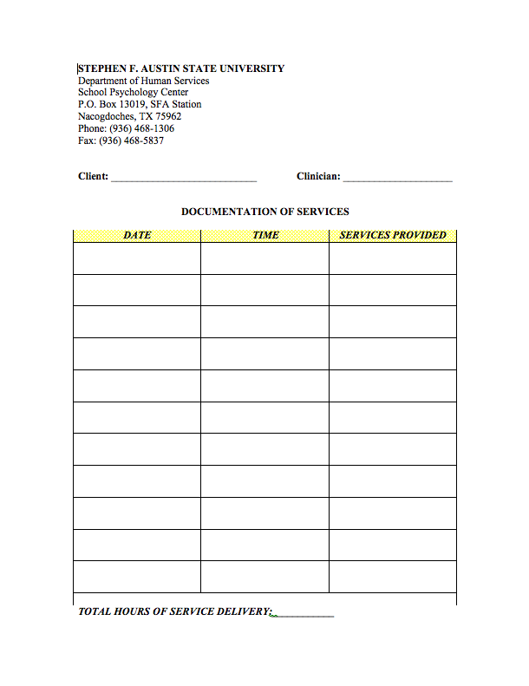
Client Paperwork
Documentation of services

Slide 50
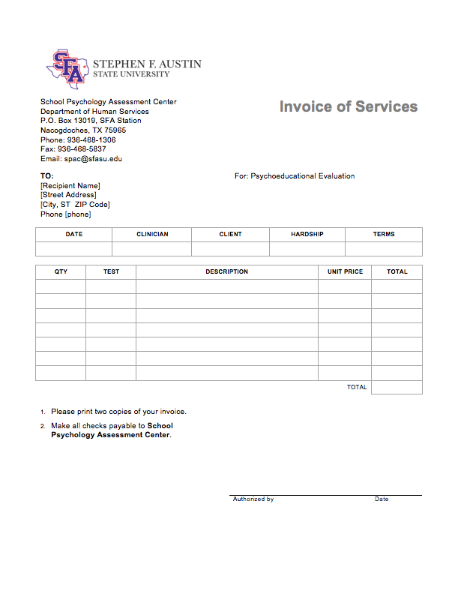
Client Paperwork
Invoices

Slide 51
Part III
Seeking Paperwork Approval
(University Counsel)

Slide 52
Paperwork Approval
This process is extensive but necessary.
Complete all center documents
Keep track of the original creation dates
Track any changes made to future documents by adding a “date modified”.
Ensure any updates are sent to your counsel for approval.
Ensure that all documents are sent to the university counsel AND follow all legal and ethical principles of our governing bodies (NASP and APA).
The university counsel will help to ensure documents are in line with the university and that documents uphold necessary legal content.
Confidentiality
Privacy
Consent to obtain and release information
Any forms with the university logo should be approved!

Slide 53
Part IV
Training Personnel

Slide 54
Training Personnel
SFASU School Psychology Program students serve as Clinicians.
professional liability insurance
HIPPA Training
School Psychology Classes
Behavior Assessment and Intervention
Psychological Foundations
Educational Foundations
Assessment (Pyschoeducational, Emotional/Behavioral)
Research Design & Statistics
Professional School Psychology
Professional Issues & Ethics

Slide 55
Training Personnel
School Psychology Program Assessment Workshop
3 day workshop offered in the Summer
Review of administration, scoring, and interpretation of measures of cognitive, achievement, adaptive, and social/emotional behavior.
Specialized assessments (Autism, ADHD, etc.)
Report writing
Additional workshops and trainings
Cross-battery Assessment
Ethics
Special Education
etc

Slide 56
Training Personnel
Licensed Supervisors
University-Based
Group supervision
Field-Based
Individual supervision
Supervision Contract Agreement
Documentation of services
Field Experience Logs
Composite/Comprehensive log of time allotted to tasks
Weekly client activity reports

Slide 57
Part V
Items Needed for Your Center

Slide 58
Items Required
Assessment materials
Intelligence scales
Achievement scales
Neuropsychological scales
Projectives
Personality
Adaptive Behavior Scales
Rating Scales
Visual/Motor
Diagnostic Interviews
Curriculum Based Assessments

Slide 59
Storage space
Assessment materials
Client records

Slide 60
Part VI
Finding a “Proper” Assessment Space

Slide 61
Finding A Proper Assessment Space
Utilize department resources
Department Administration Assistant
Other faculty
Graduate Assistants

Slide 62
Proper Assessment Space
Collaborate with other departments
Speech Language
Counseling
Student Health Center

Slide 63
Part VII
Marketing Your Services

Slide 64
Marketing your services
Marketing to the university
Counseling Services
SFA Counseling Clinic
Disability Services
SFA 101- freshman services
Marketing to the community
Brochures, Website, Business Cards,
Physician Campaign
Working with specific organizations on center development efforts.
Interagency Coalition
Mission Possible- Burke Center
SFA Counseling Services

Slide 65
Part VIII
Maintaining Client Records

Slide 66
Maintaining Client Records
HIPAA
Insurance
APA Record Keeping Guidelines
Confidentiality
Privacy
Emails
Client Records

Slide 67
Part IX
Maintaining the Life of Your Center

Slide 68
Student Involvement
Ensure that students know the mission of your SPAC
Ensure they understand the paperwork and items they will use
Ensure they have been properly trained on assessments used
Ensure that the number of cases taken are not overwhelming, but that students are learning from the experiences they have.
Make students aware of training opportunities
Make students aware of research opportunities
Involve students in outreach initiatives

Slide 69
Faculty Involvement
Involve faculty who have different licenses and certifications
Know your LSSPs and LPs in the area for future collaborations.
Collaborate with various faculty on campus
Make faculty aware of services offered in your SPAC
Invite faculty to participate in multidisciplinary assessment
Make faculty aware of research opportunities

Slide 70
Activity Time!!!

Slide 71
Activity 1
Considering all the components discussed in today’s SPAC presentation, how would you create your own SPAC?
Mission?
Goals and Objectives?
Collaborators?
Obstacles you may encounter?

Slide 72
Activity 2
What procedure would you use for the following referral?

Slide 73
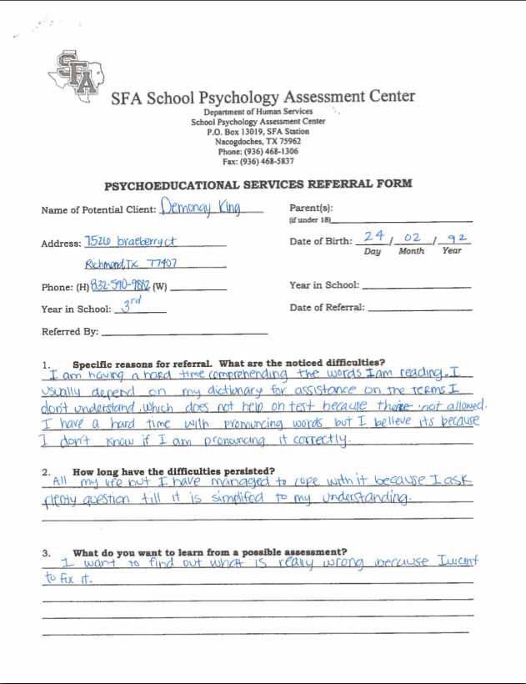
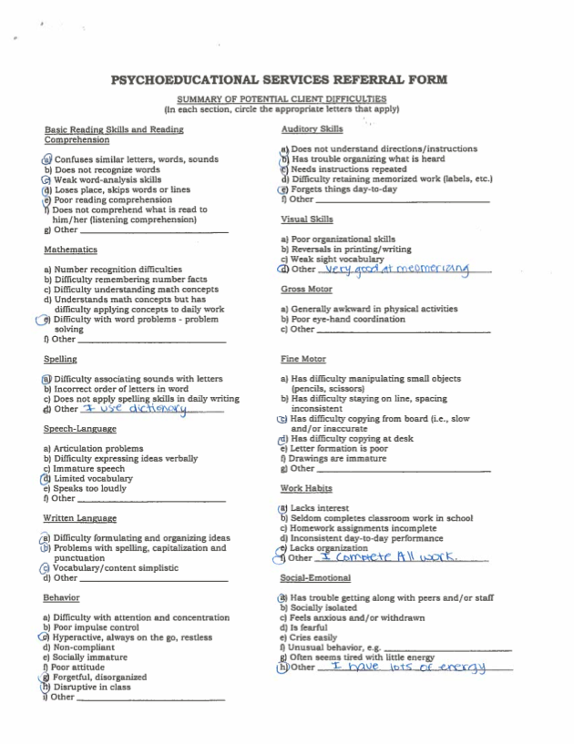

Slide 74
Thank You for Your Attendance!

Slide 75
References
Atkins, M., Adil, J., Jackson, M., McKay, M., & Bell, C. (2001). An ecological model for school-based mental health services. 13th Annual Conference Proceedings: A System of Care for Children's Mental Health: Expanding the Research Base. Tampa: University of South Florida.
Atkins, M. S., Frazier, S. L., Adil, J. A., & Talbott, E. (2003) School-based mental health services in urban communities. In M. Weist, S. Evans, & N. Tashman (Eds.), Handbook of school mental health: Advancing practice and research (pp. 165– 178). New York: Kluwer Academic.
Doll, B., & Cummings, J. A. (2008). Best practices in in population-based school mental health services. In A. Thomas & J. Grimes (Eds.), Best practices in school psychology V. (pp 1333-1347). Bethesda, MD: National Association of School Psychologists.
Flaherty, L. T., & Osher, D. (2003). History of school-based mental health services. In M. D. Weist, S. W. Evans, & N. A. Lever (Eds.), Handbook of school mental health: Advancing practice and research (pp. 11–22). New York: Kluwer Academic.
Flaherty, L. T., & Weist, M. D. (1999). School-based mental health services: The Baltimore models. Psychology in the Schools, 36, 379–389.
Jacoby, W. G. (2005). School-Based Mental Health Programs and Services: Overview and Introduction to the Special Issue. Journal of Abnormal Child Psychology, 33(6), 657-663.
Paternite, C. E. (2004). Involving educators in school-based mental health programs. In K. E. Robinson (Ed.), School-based mental health: Best practices and program models (pp. 6–1 – 6–21). Kingston, NJ: Research Institute, Inc.
Rones, M., & Hoagwood, K. (2000). School-based mental health services: A research review. Clinical Child and Family Psychology Review, 3, 223–241.
Smith-Bailey, D. (2003). Building an independent practice. Monitor of Psychology, 34(9), pp. 40.
Weist, M. D., Evans, S. W., & Lever, N. A. (Eds.). (2003). Handbook of school mental health: Advancing practice and research. New York: Kluwer Academic.

